Slide 1
Unveiling Utah's Air: A Look at Air Sensor Data
April 29th, 2024
Kolby, Harshitha, Kavita, & Huong

Slide 2
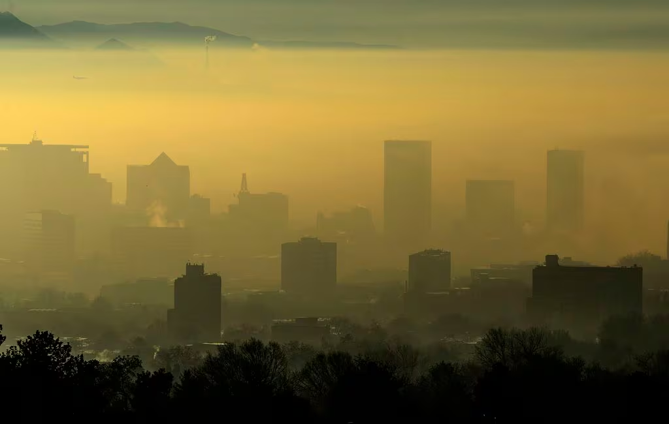
A Breath of Fresh Air? Not Always…
Utah's unique geography and weather patterns contribute to air quality concerns.
Industrial activities and population growth further exacerbate the issue.
Poor air quality poses health risks, especially for vulnerable populations.
Low-cost sensors offer a potentially widespread air quality monitoring solution.
Data quality and reliability can be a concern, especially for research purposes.

Slide 3
Our Project
Data Source
Analysis Scope
Data Quality
Visualizations
Impact
Utah PurpleAir Sensors
EPA Sensors
Sensors within Salt Lake County
Data Completeness
Accuracy
Sensor Uptime
Map of PurpleAir/EPA Sensors
Comparative Charts
Improved Public Health Decisions
Resource Allocation
Reduction in Air Pollution

Slide 4
Data Acquisition
Data was acquired from PurpleAir public sensors and EPA public data
Data used were daily measurements of PM2.5 and PM10
Data was downloaded in CSV files
EPA Data
Downloaded per year
Found on EPA website
More information on many specific pollutants
PurpleAir Data
Downloaded per sensor
Requires API key and download tool
Limited to PM2.5 and PM10

Slide 5
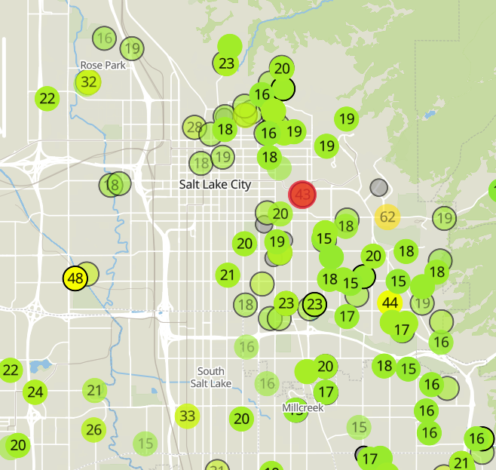
Data Acquisition
Sensors were selected from across Salt Lake County and matched from EPA data to the PurpleAir Sensor map using latitude and longitude to compare similar areas
Sensor locations:
Copperview Elementary
Kensington Ave Hawthorn
Riverside Park (Rose Park)
Jordan Meadows(Utah Technical Center)
Near Road
Data Acquisition ended with 8 EPA files and 5 PurpleAir files

Slide 6
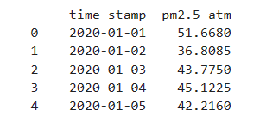
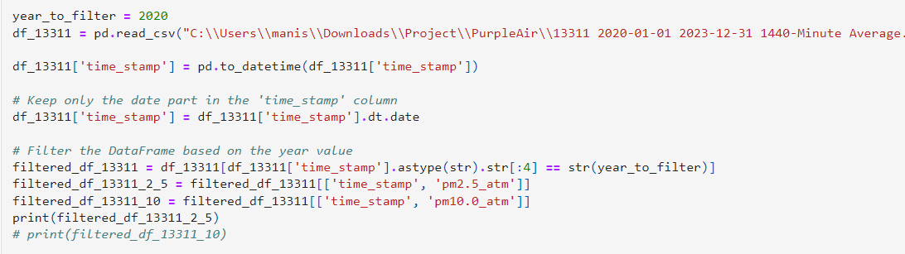
Data Processing
Reading and Filtering for PurpleAir:
Imported data from CSV files into pandas DataFrames.
Filtered the data based on the year specified.
Extracted relevant columns like 'time_stamp', 'pm2.5_atm', and 'pm10.0_atm'.

Slide 7
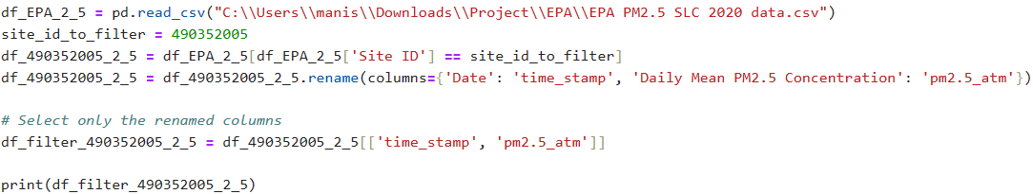
Data Processing
Date Reading and Filtering for EPA site
Filtered data with site id for PM2.5 and PM10 as data was given year wise
Rename column same as in PurpleAir Year sheet and extracted that column.

Slide 8
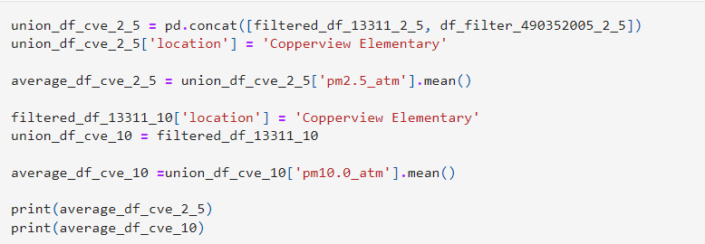
Data Processing
Data Concatenation:
Concatenated data from PurpleAir and EPA sources for the same location.
Added a 'location' column to identify the source of each data point.
Calculated average concentrations of PM2.5 and PM10.0 for each site using mean function

Slide 9
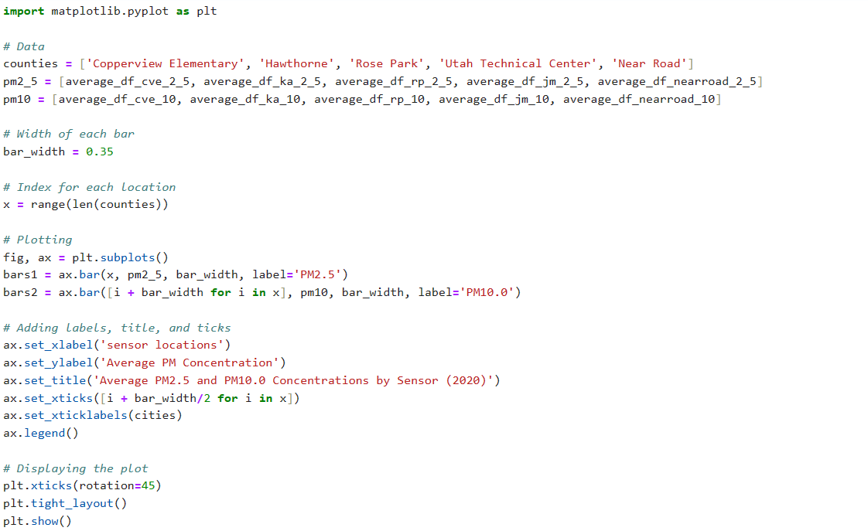
Data Processing
Results Presentation:
Printed out the average concentrations for each site and pollutant.

Slide 10
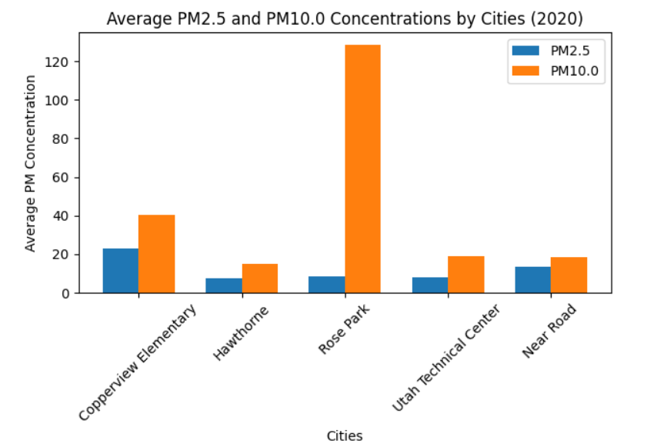
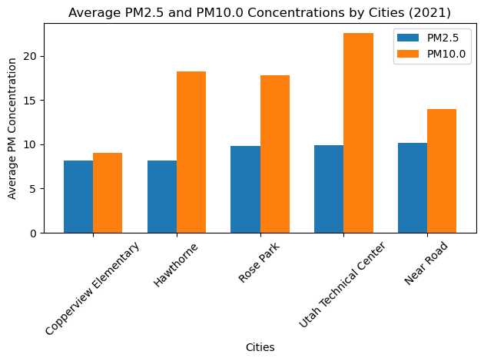
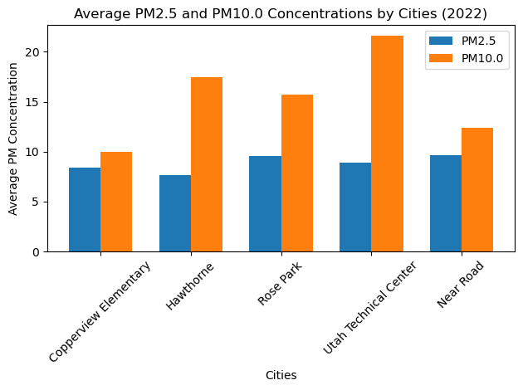
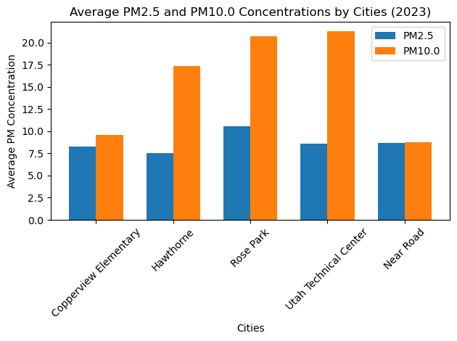

Slide 11
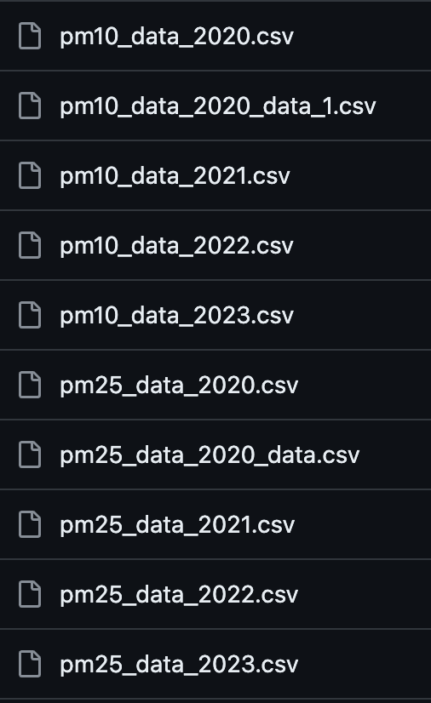
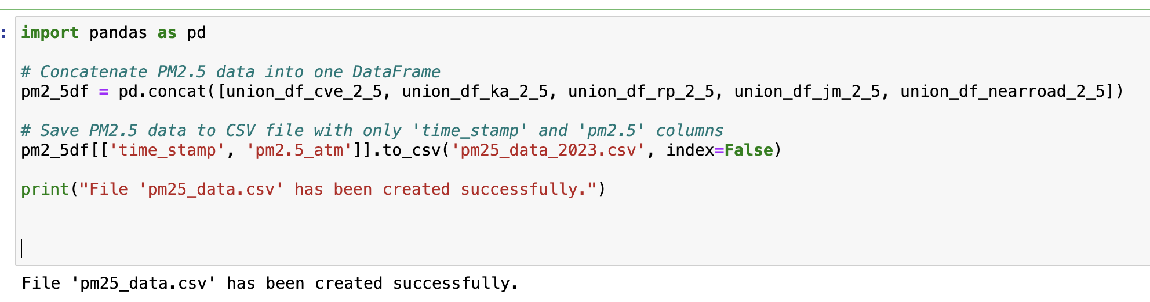
Putting It All Together
Merged individual data frames for PM2.5 data from different locations into a single dataframe for each year.
The file explorer on the right shows various CSV files named by year and pollutant type, indicating organized data storage for easy access

Slide 12
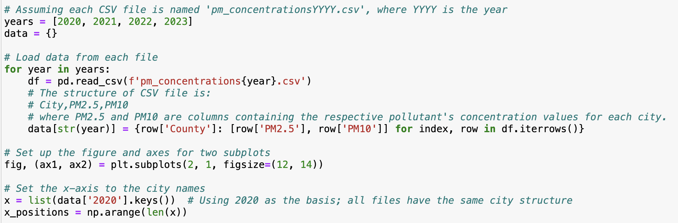
Data Ingestion: Code iterates over yearly CSVs to compile PM2.5 and PM10 data into a dictionary keyed by year.
Visualization Setup: Establishes a plotting framework with subplots for comparative analysis of counties' air quality data.

Slide 13
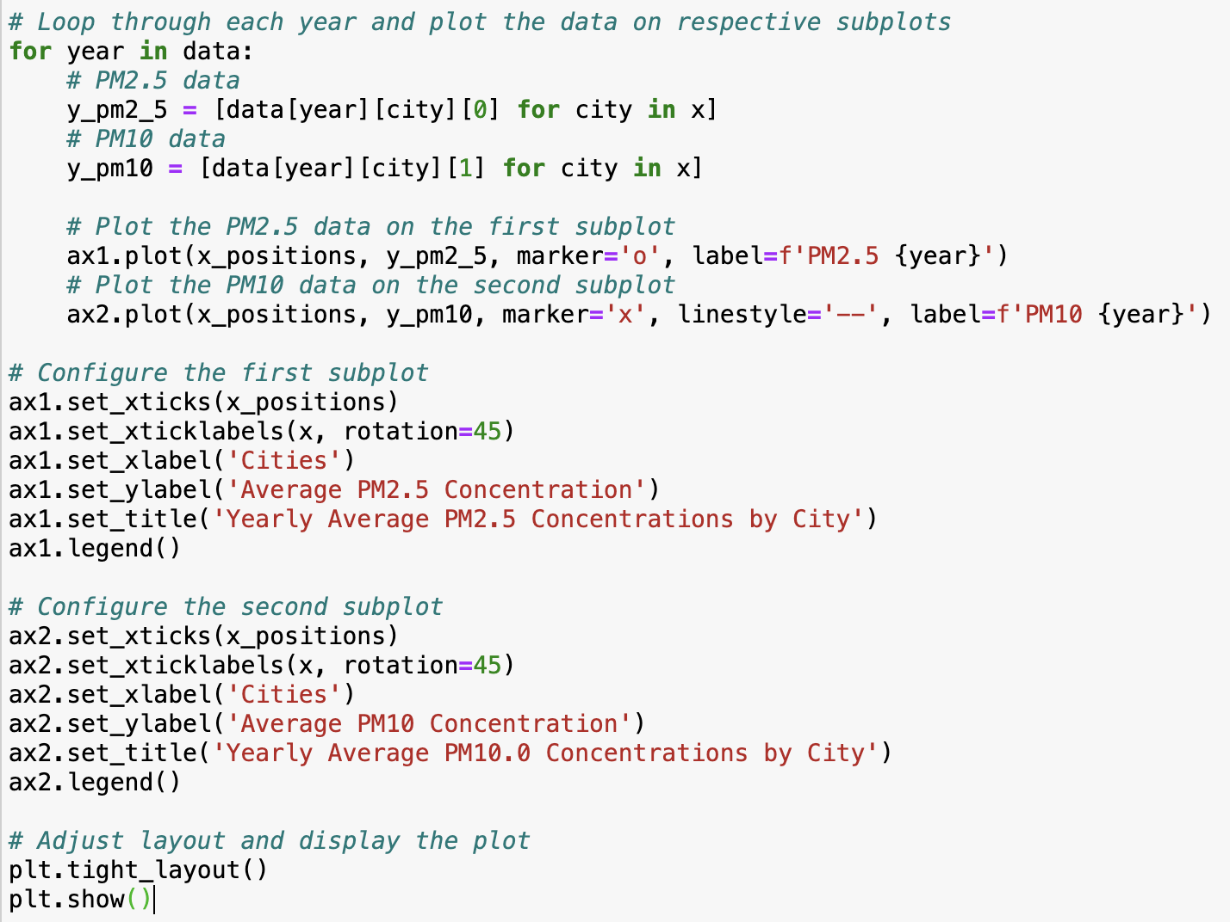
Looping & Plotting: Code loops to plot annual PM2.5 and PM10 data by county, using distinct markers for each.
Subplot Customization: Each subplot is labeled and titled, showing average concentrations per county.
Legend & Layout: Legends are added for clarity, and layout adjustments enhance readability.
Display Command: Finalizes the visualization with plt.show() to display the plots.

Slide 14
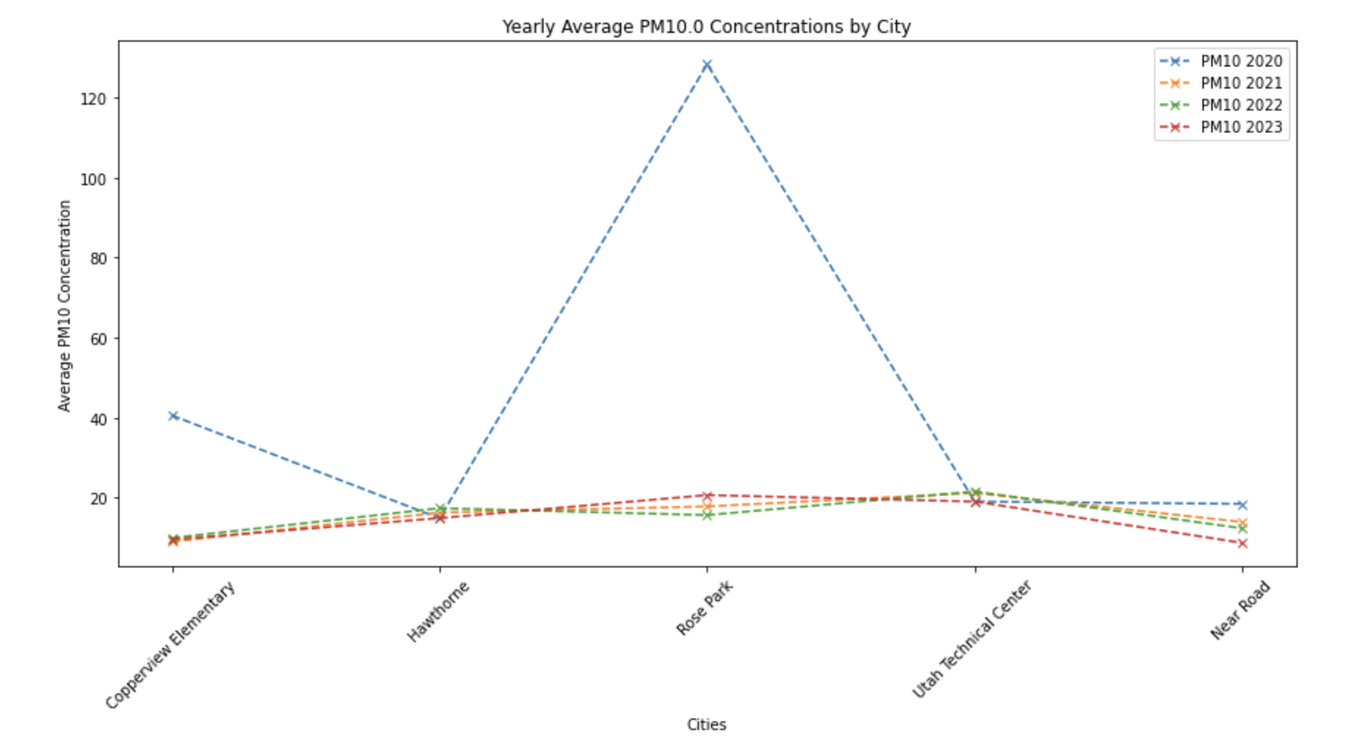
This graph illustrates the yearly average PM10 concentrations by city, featuring a notable spike in Rose Park in 2022

Slide 15
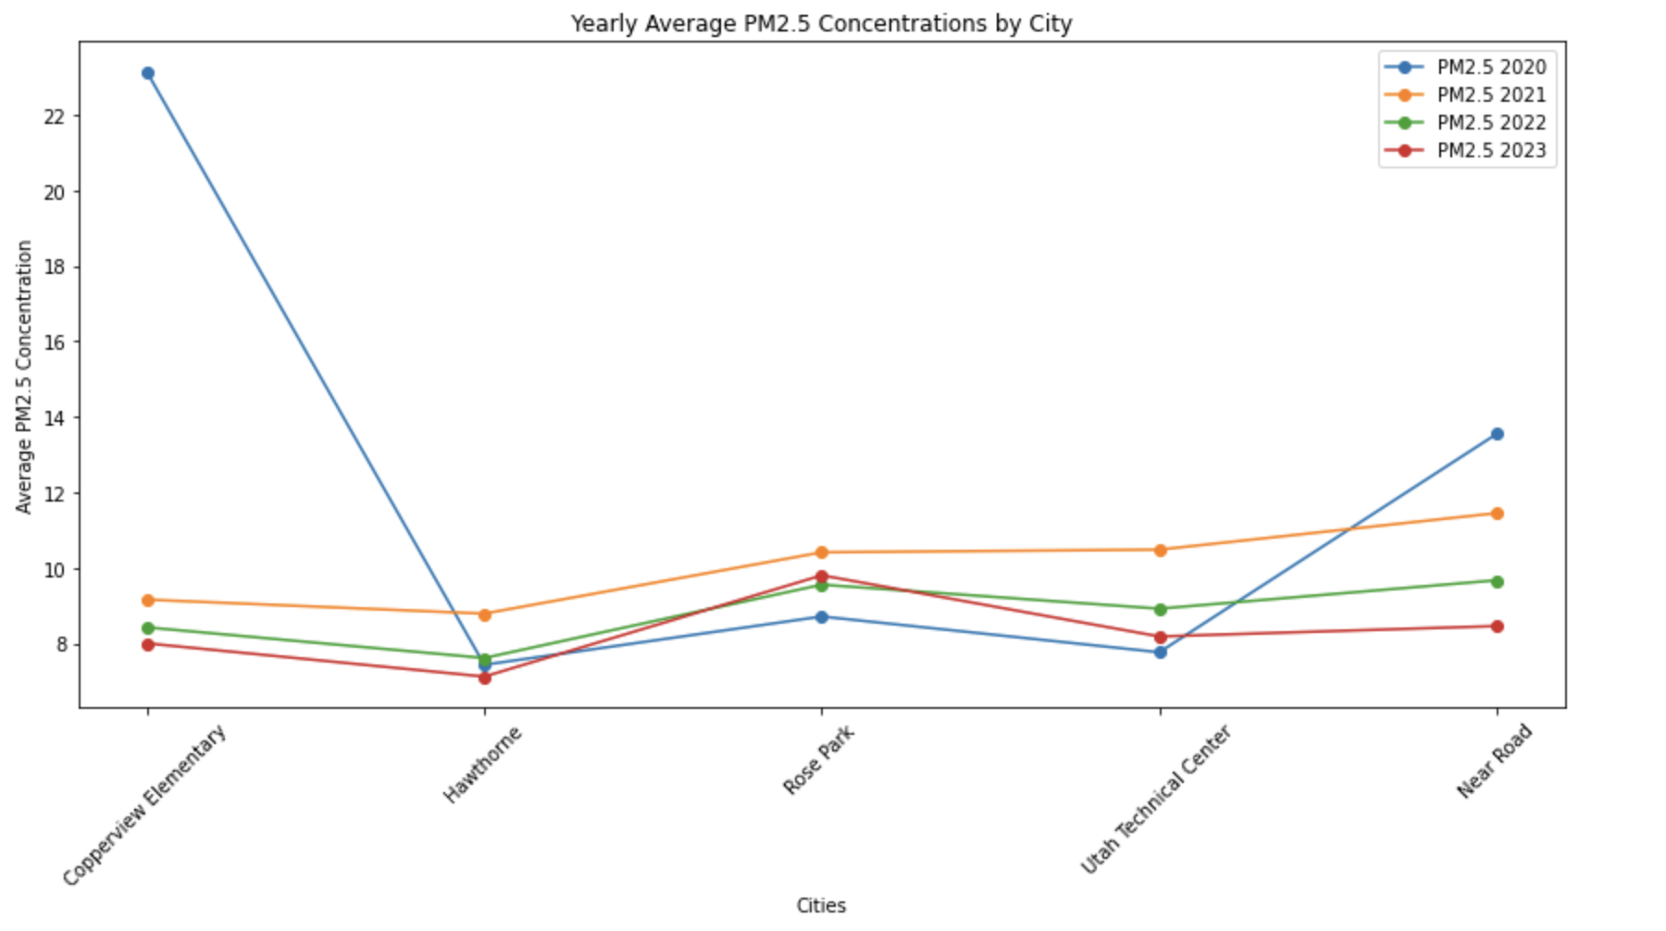
This graph shows the yearly average PM2.5 concentrations by city, with most counties displaying a consistent trend over the four years, while the 'Near Road' location shows an increasing trend.

Slide 16
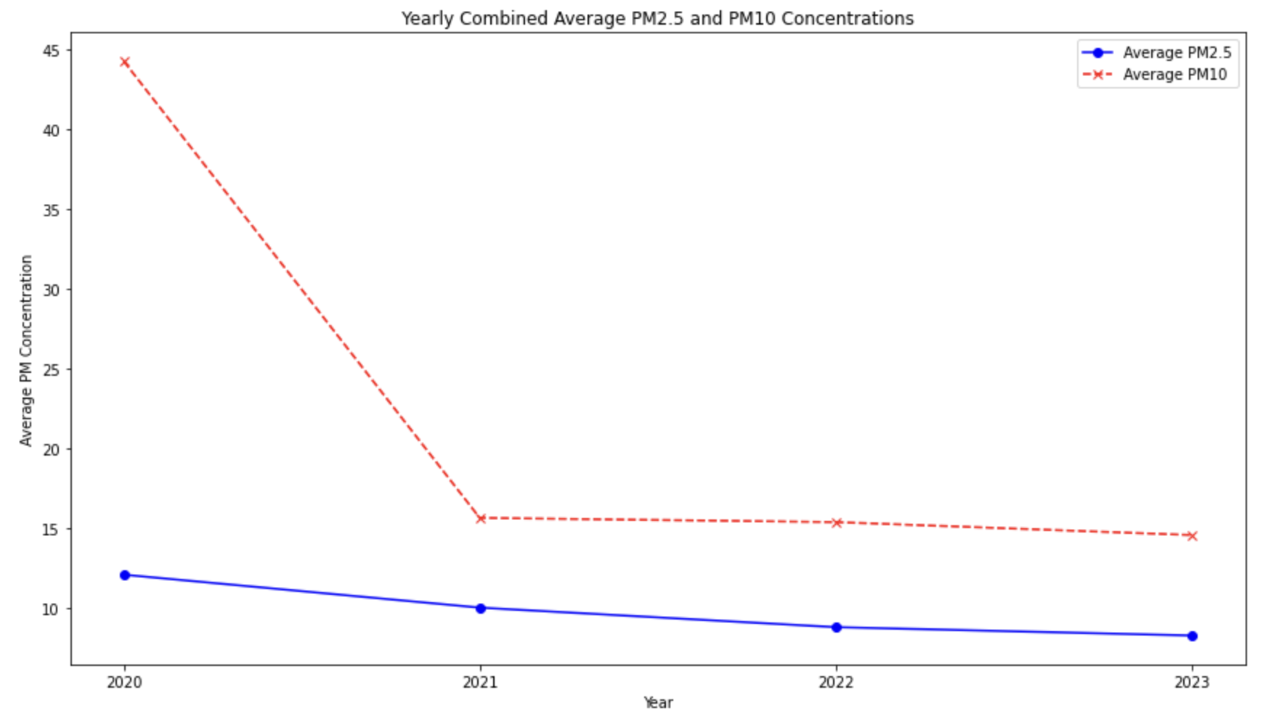
The combined graph depicts a general decline in the yearly average concentrations of PM2.5, while PM10 concentrations show more variation with a significant peak in 2021.

Slide 17
Sensor
Thank you!
Questions?

